Slide 1
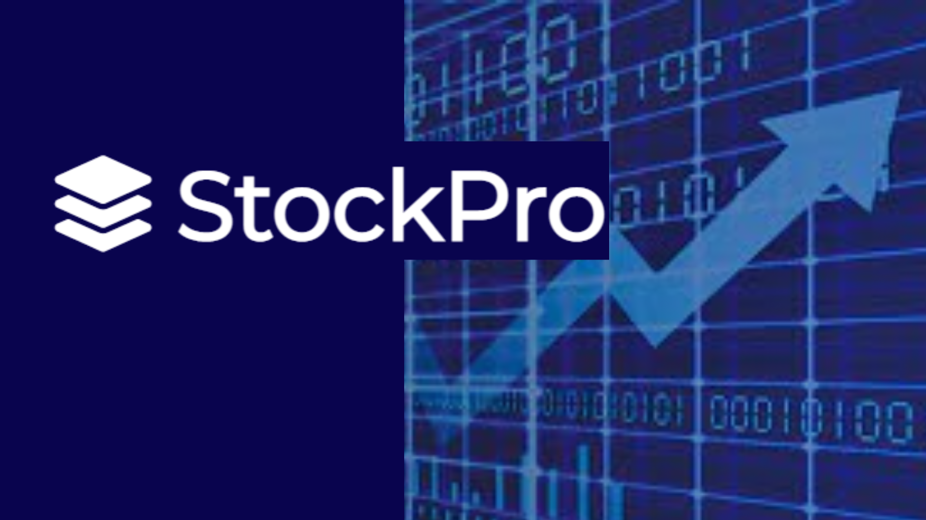
Submitted By: Roll No.:
Akul Mangal B092
Nikhelesh Bhattacharyya B081
Ajay Sudharshan Satish B088

Slide 2
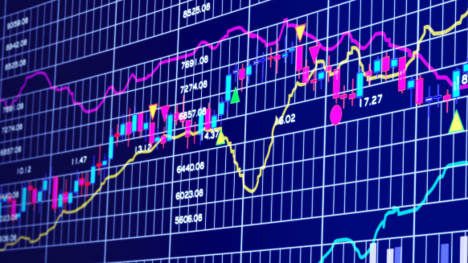
Problem Statement
Financial investors of today are facing this problem of trading as they do not properly understand which stocks to buy or which stocks to sell to get optimum profits.
Predicting long term value of the stock is relatively easier than predicting on day-to-day basis as the stocks fluctuate rapidly every hour based on world events. The rate of investment and business opportunities in the stock market can increase if an efficient algorithm could be devised to predict the short-term price of an individual stock.
After surveying 18 successful NSE stock traders, a similar concern/problem was found, like issue finding a trading platform that caters to all their needs. They had to place stock orders physically/through call, browse through multiple websites for information, manually work out several exhausting calculations to produce all these wants.

Slide 3
What is a Stock?
What is Stock Analysis?
What is Stock market prediction?
What is Stock Trading?
MOTIVATION & SCOPE
We have noted down all these requirements and worked towards fulfilling each one of them in a single website “ Stock Pro” so that investors can conveniently analyze, trade and predict future stock prices of all NSE stocks/their holdings.
The users of this system include any individual above 18 years of age who has a PAN card and Demat Account Number.
Investors will be to be able to view all their stocks in a consolidated manner in one place instead of keeping track for each company’s stock separately.

Slide 4











Software & API Used

Slide 5
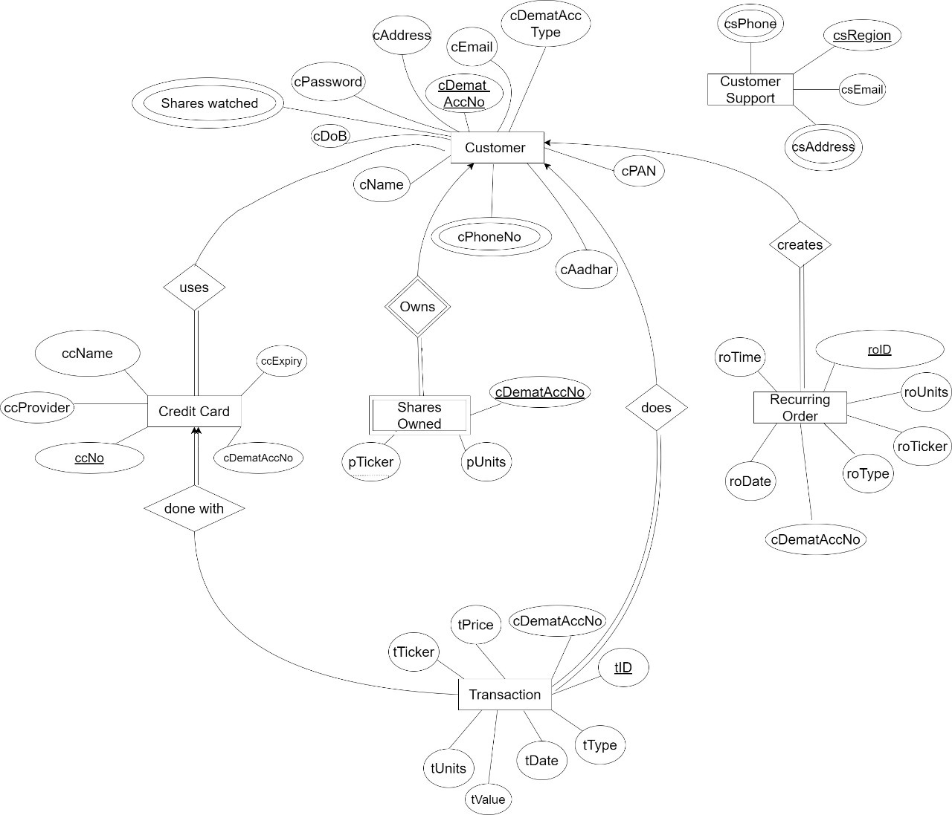
Entity Relationship Model

Slide 6

Tables

Slide 7
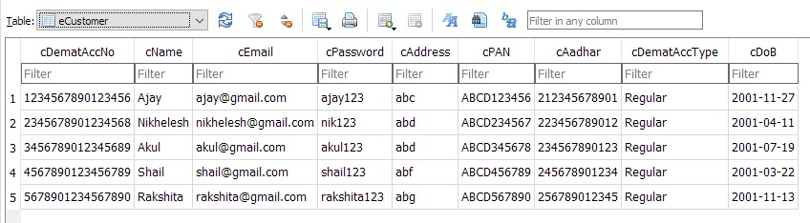
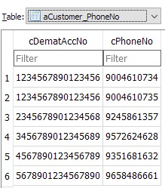
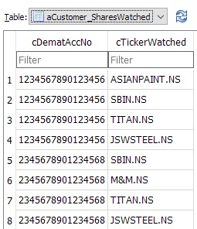
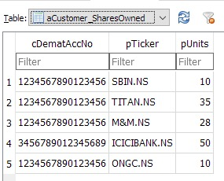
eCustomer
All tables are in
Boyce Codd Normal Form (BCNF)

Slide 8
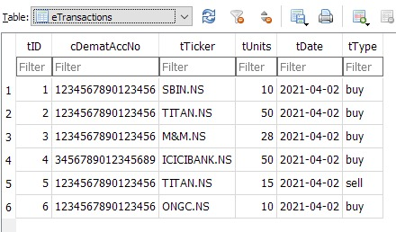
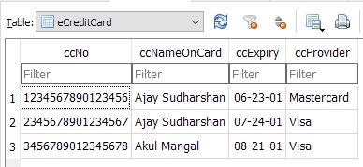
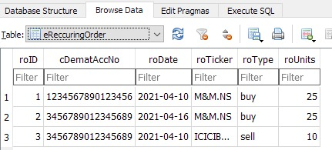
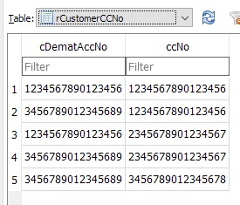
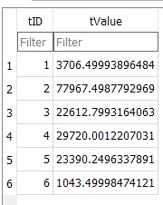
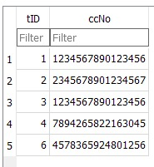
eTransaction
eCreditCard
All tables are in
Boyce Codd Normal Form (BCNF)
eRecurringOrder

Slide 9
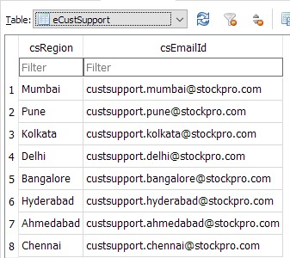
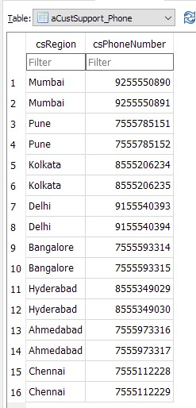
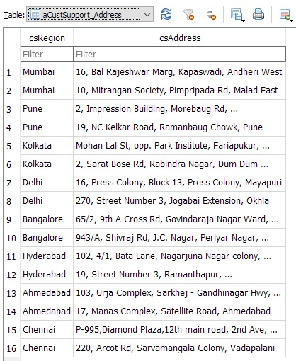
All tables are in
Boyce Codd Normal Form (BCNF)
eCustSupport

Slide 10

Linking & Implementation

Slide 11

Layouts / Visualization

Slide 12
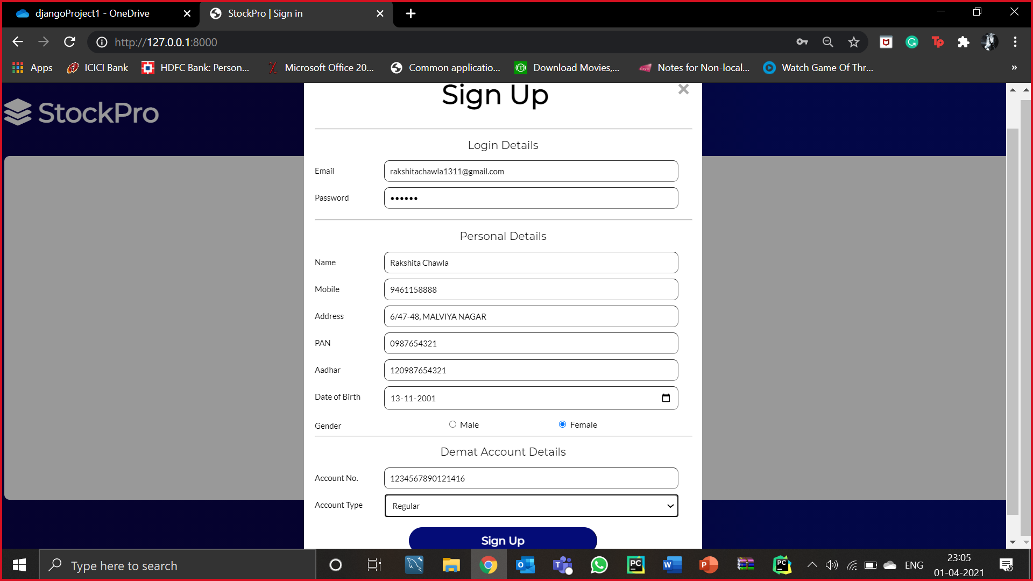
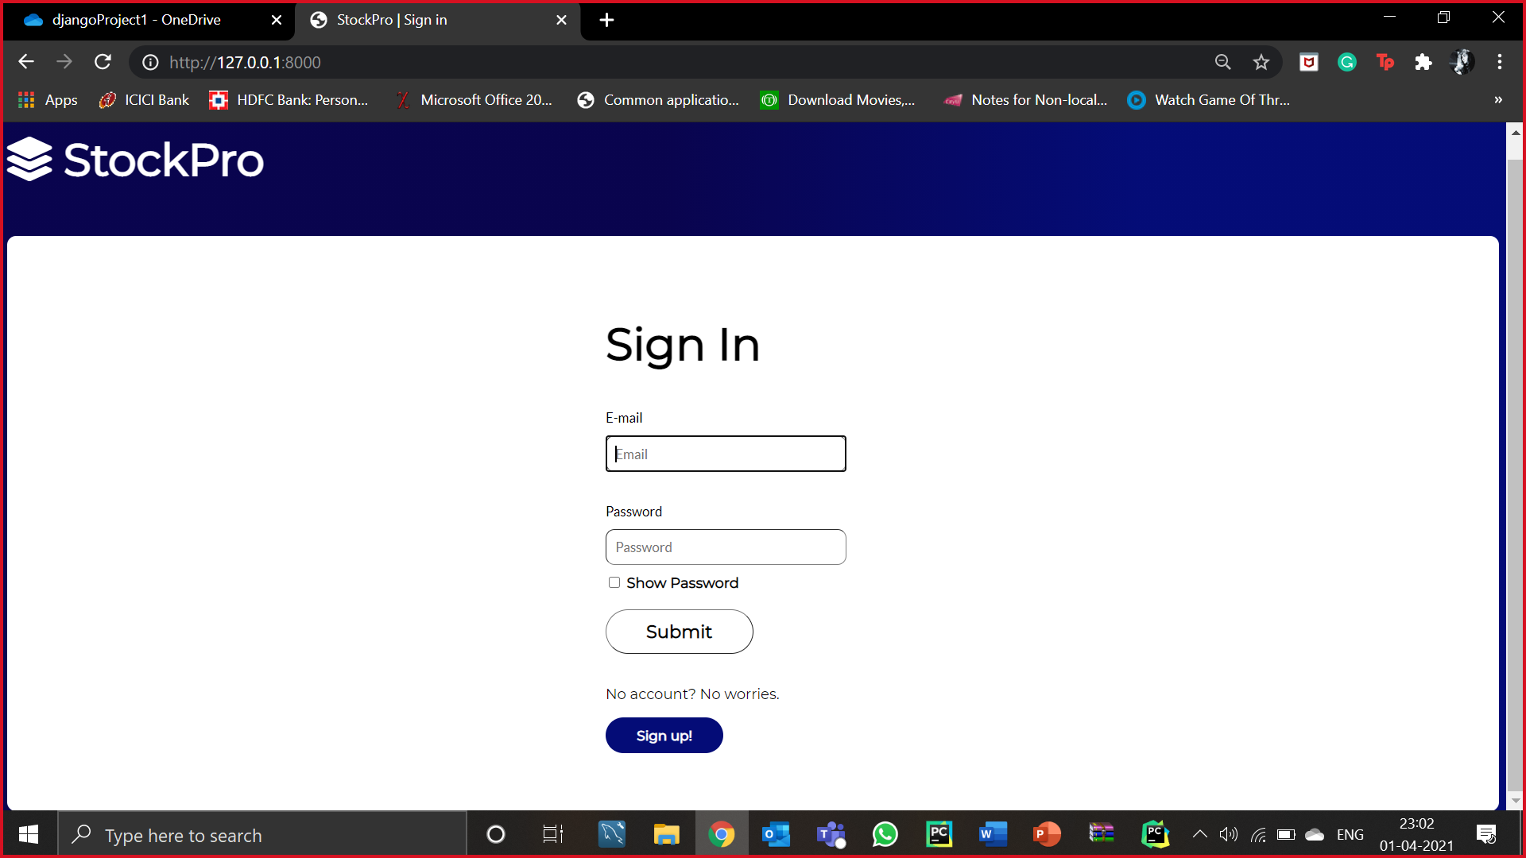
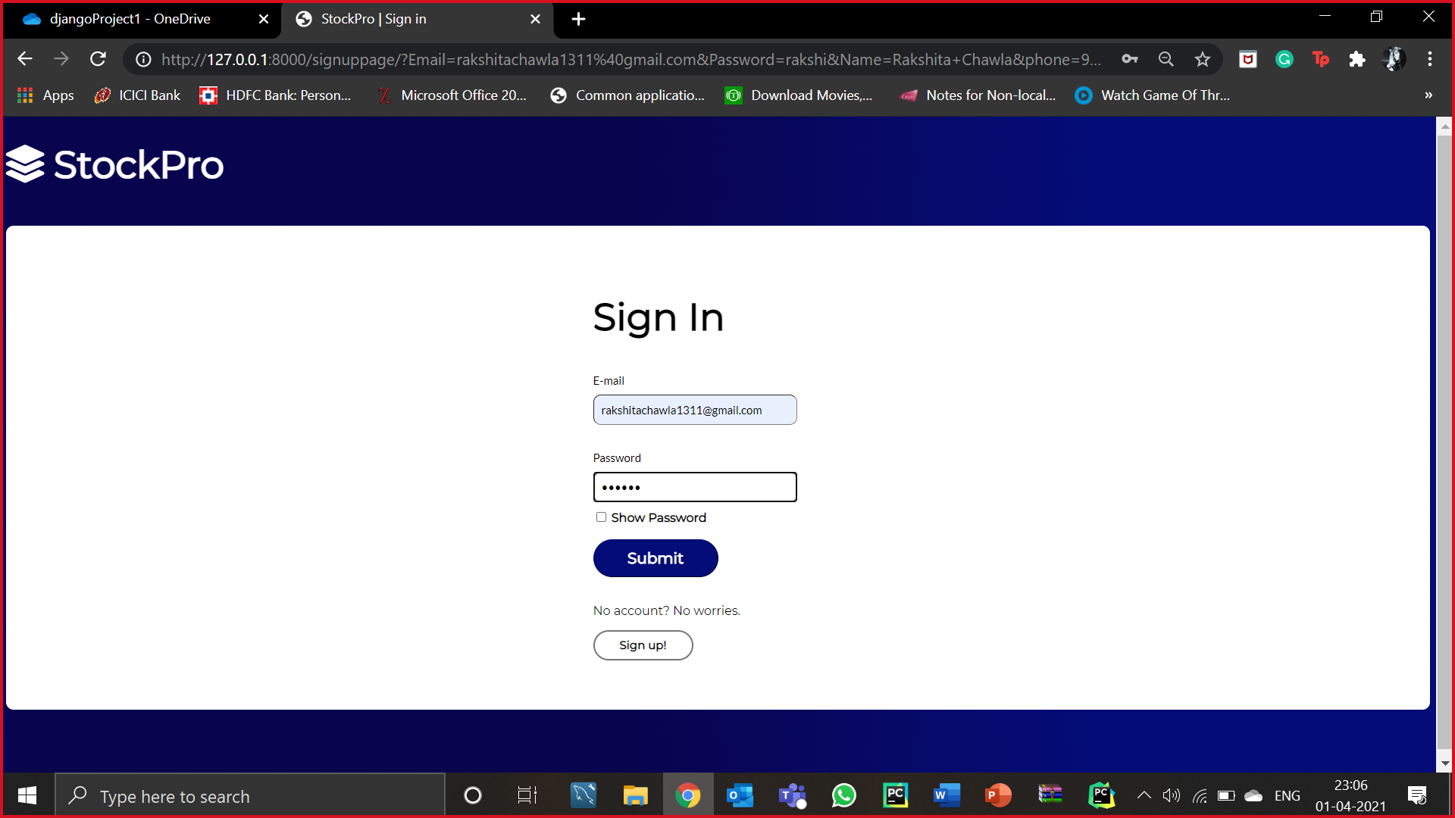
SIGN UP FOR AN ACCOUNTC
SIGN IN TO YOUR ACCOUNT

Slide 13
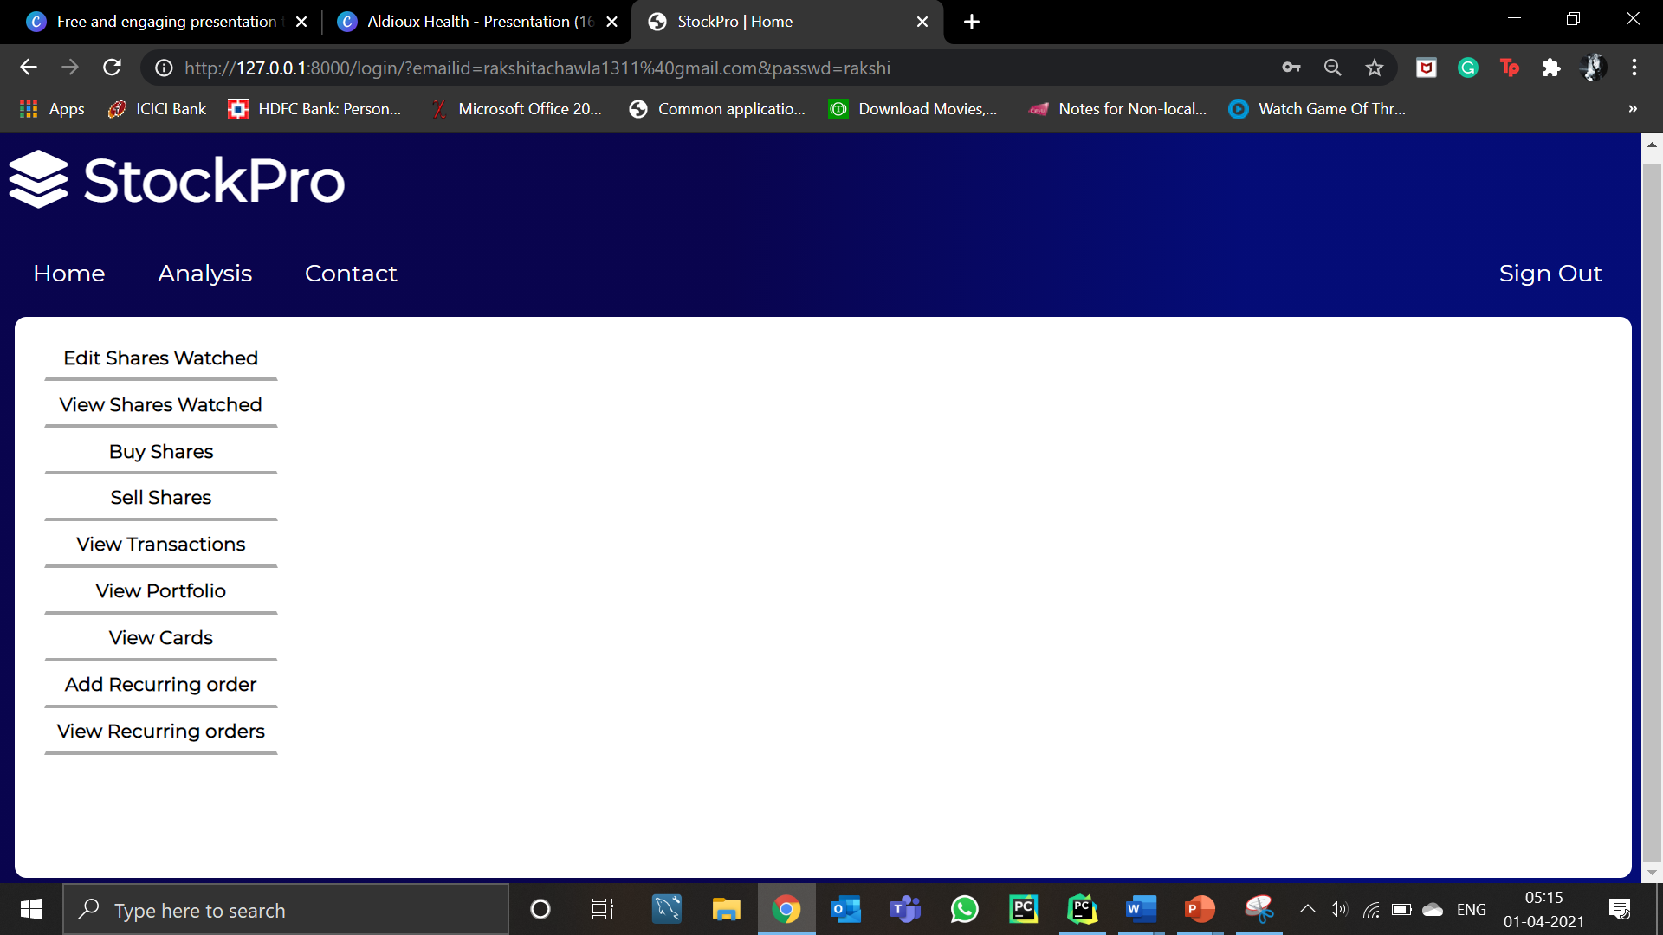
HOME PAGE OF OUR WEBSITE

Slide 14
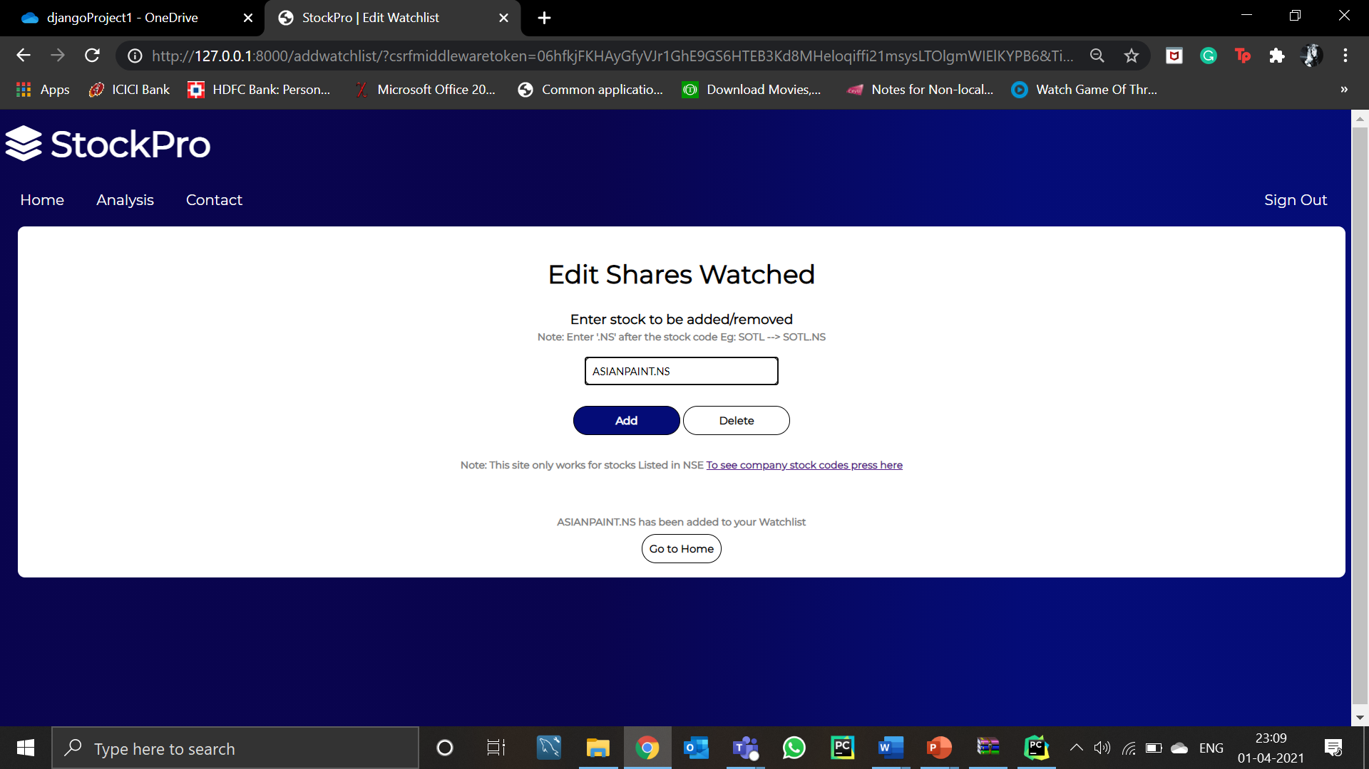
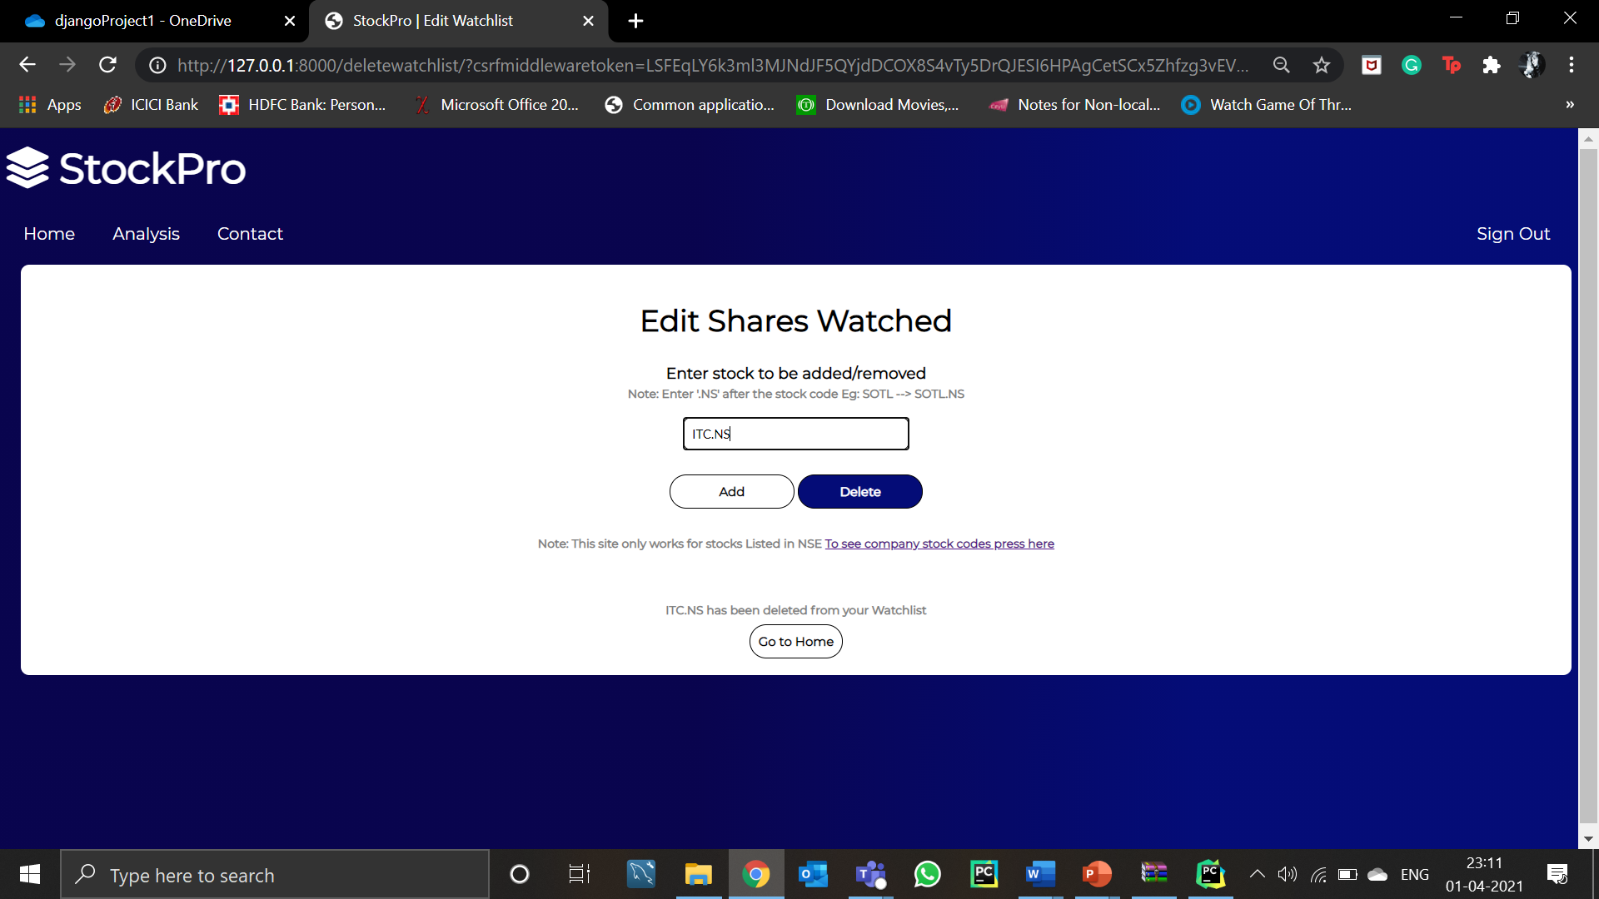
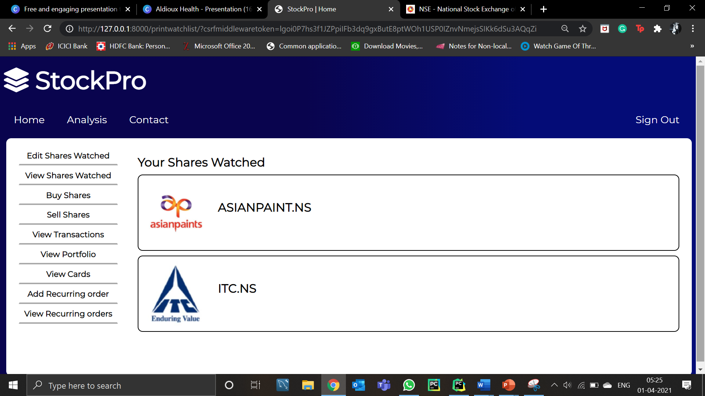
Edit shares you’ve watched
Add share to the list
Remove share from the list
List of shares you’ve watched

Slide 15
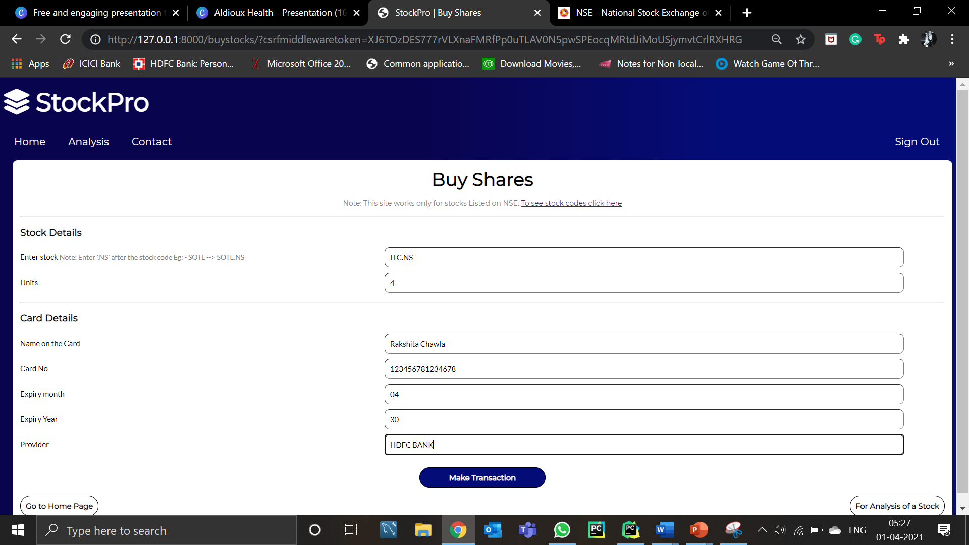
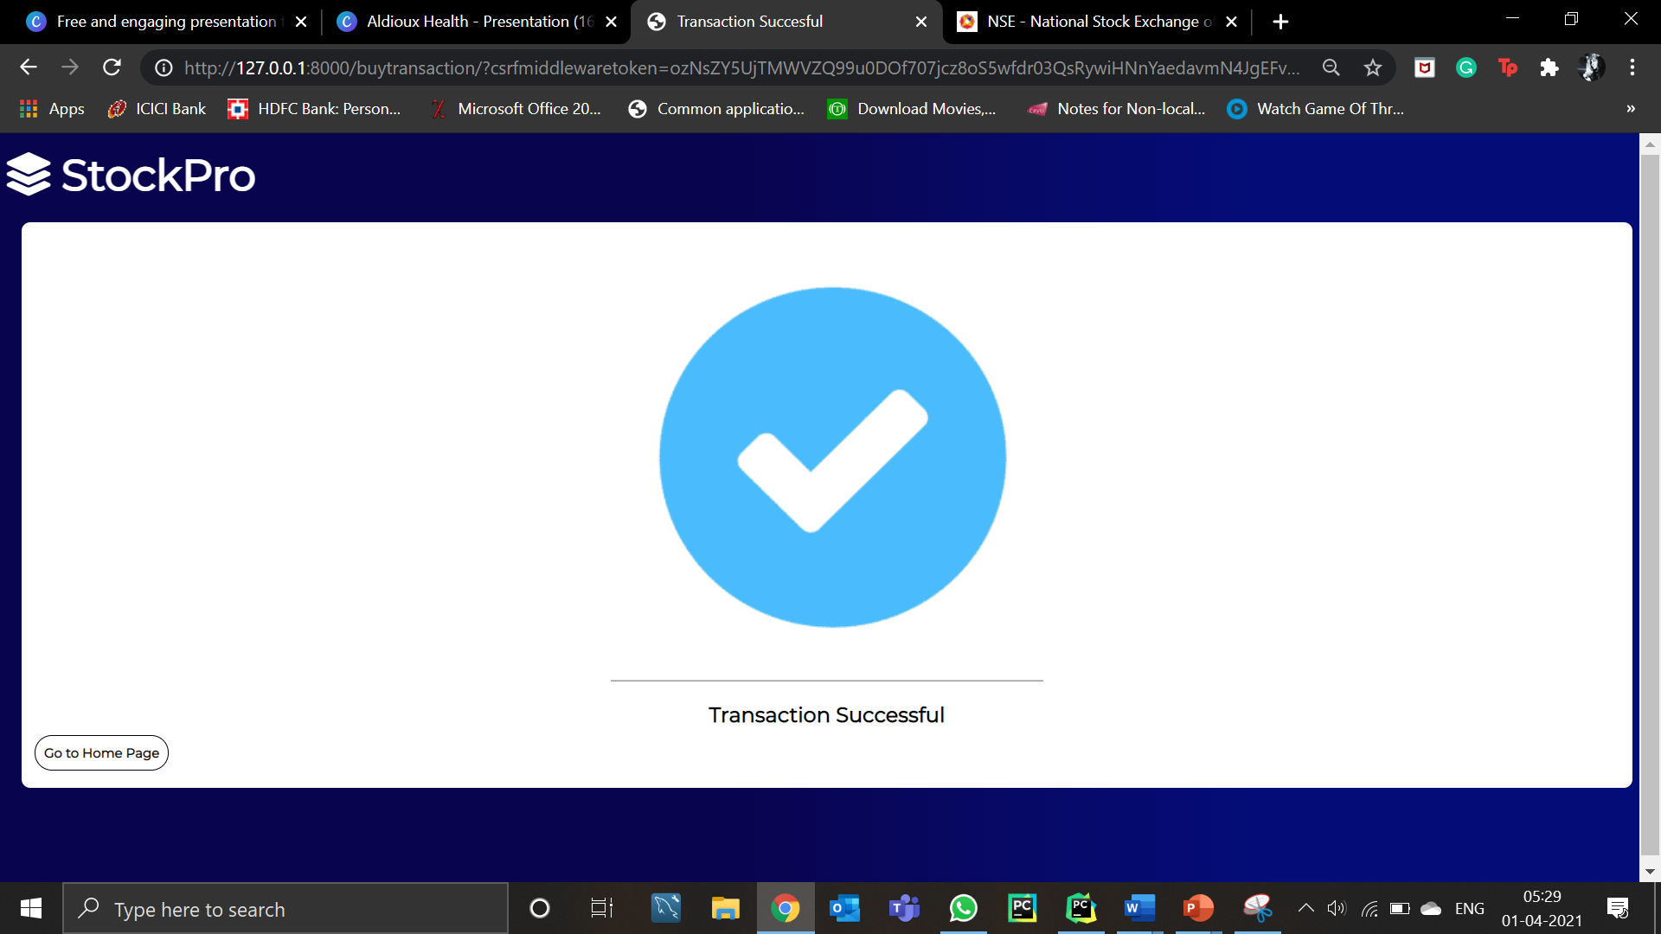
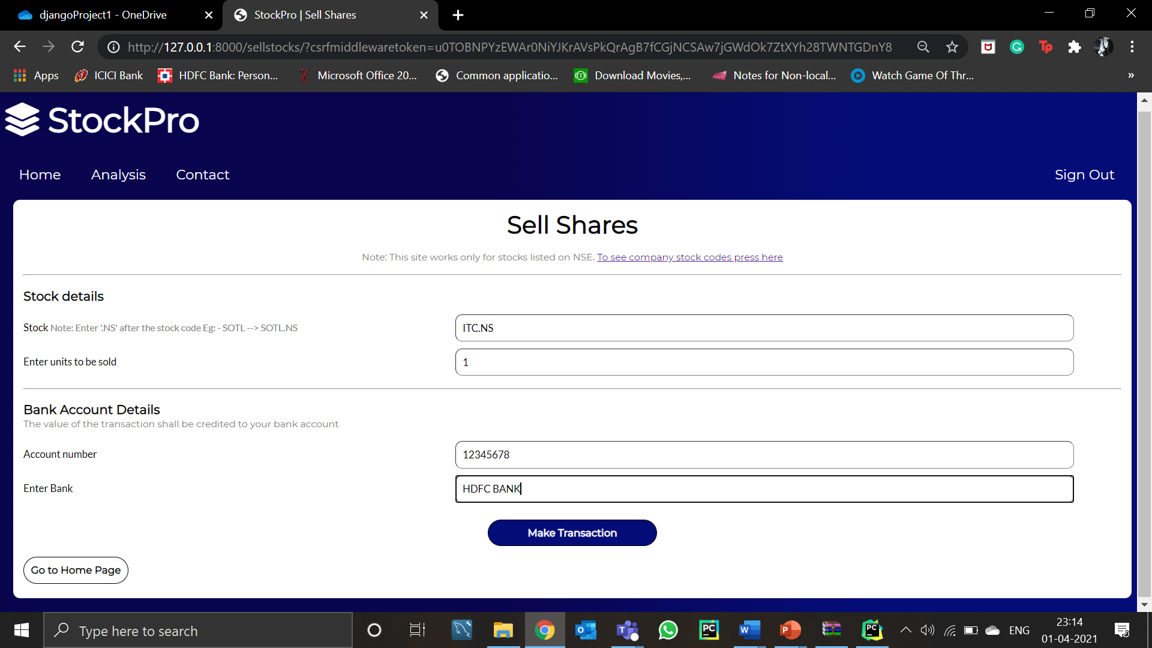
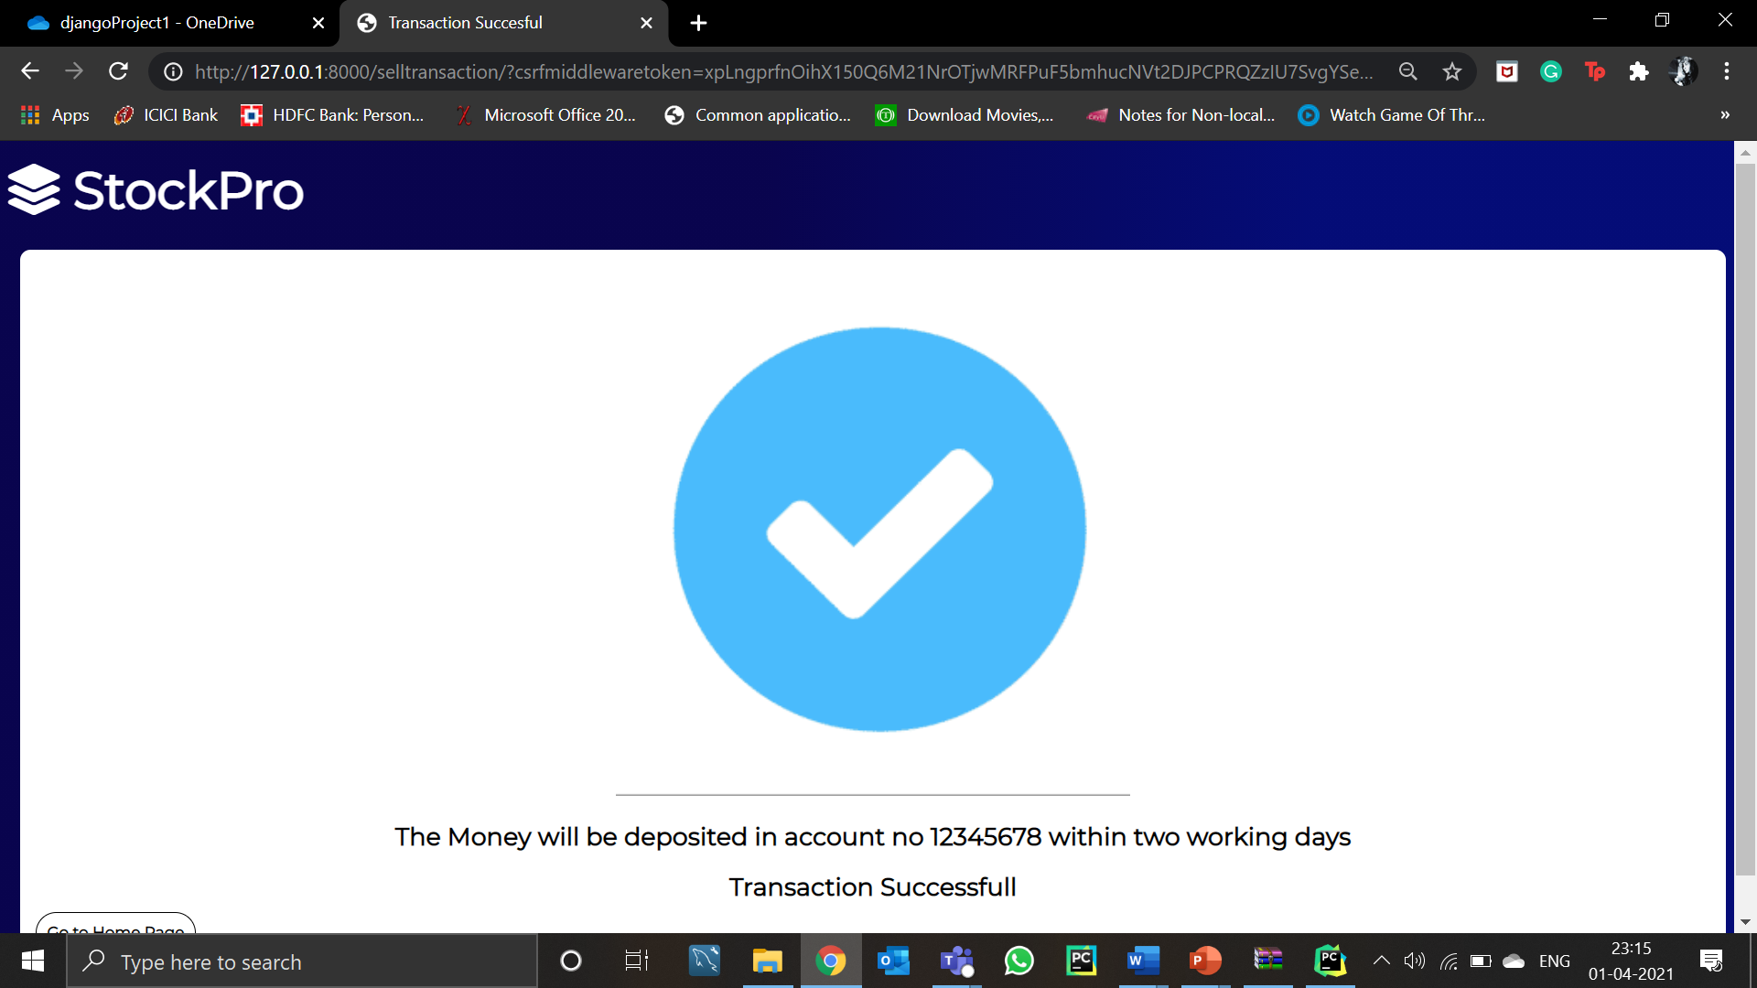
BUY SHARES
SELL SHARES

Slide 16
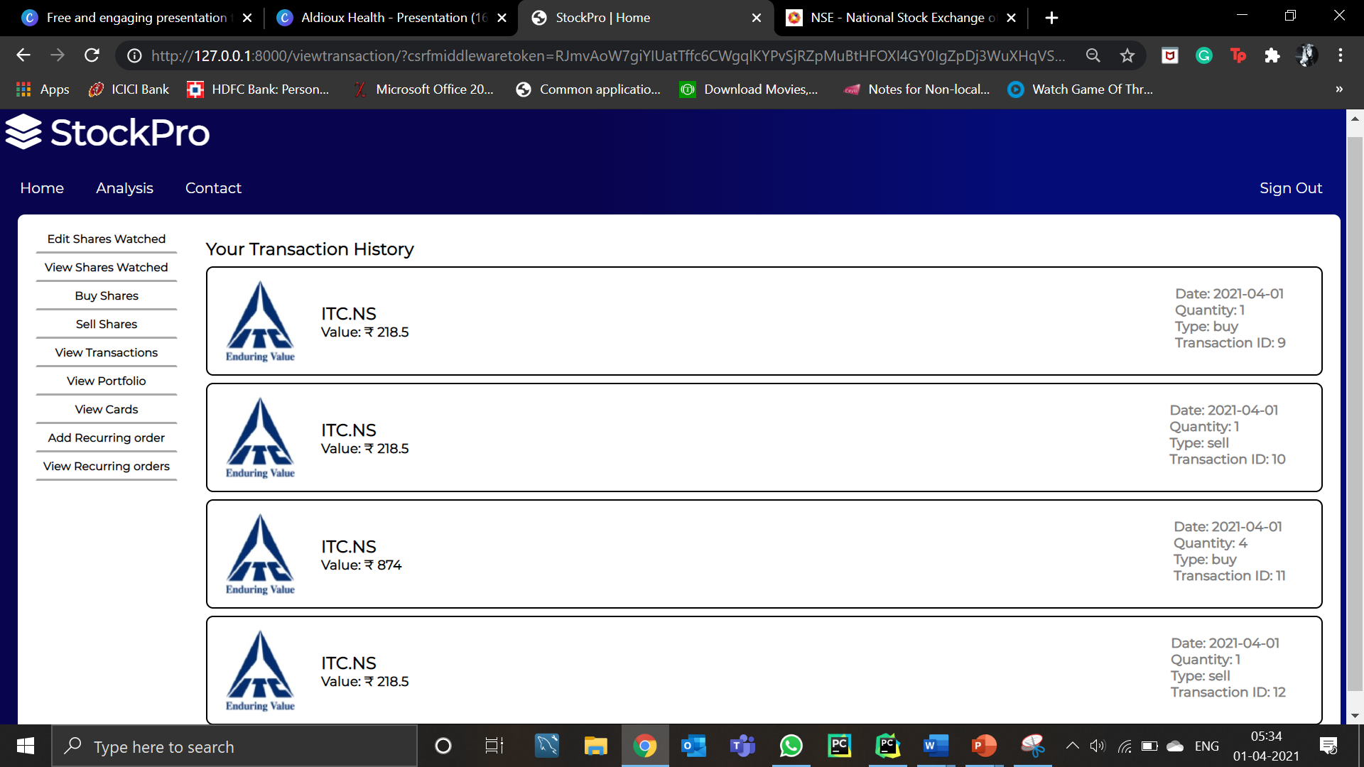
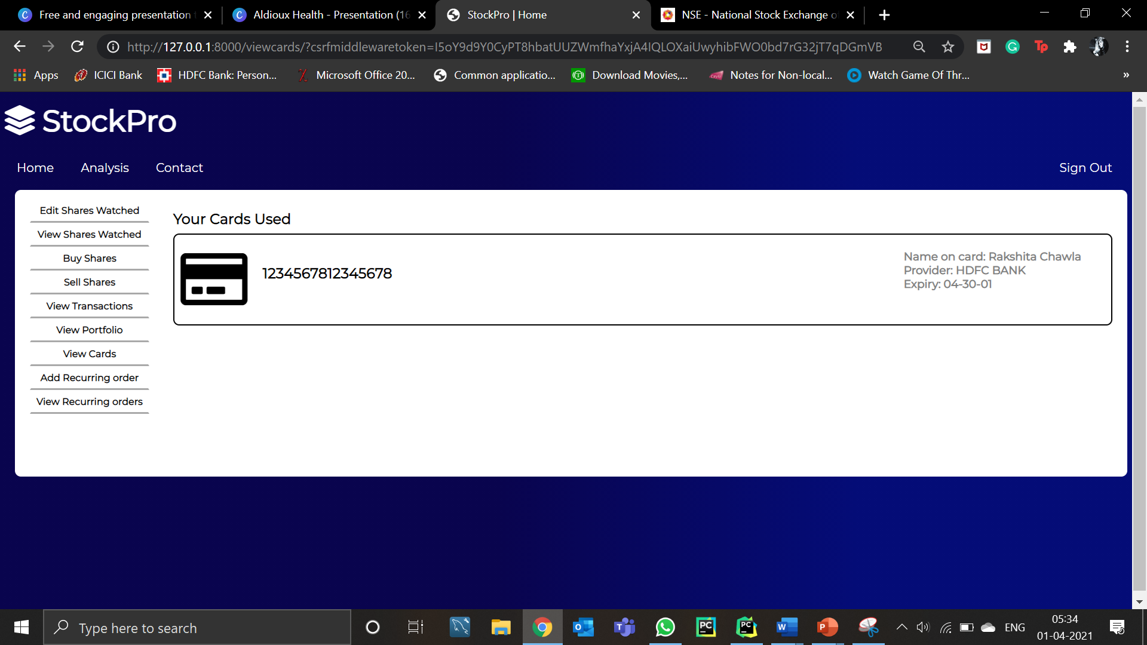
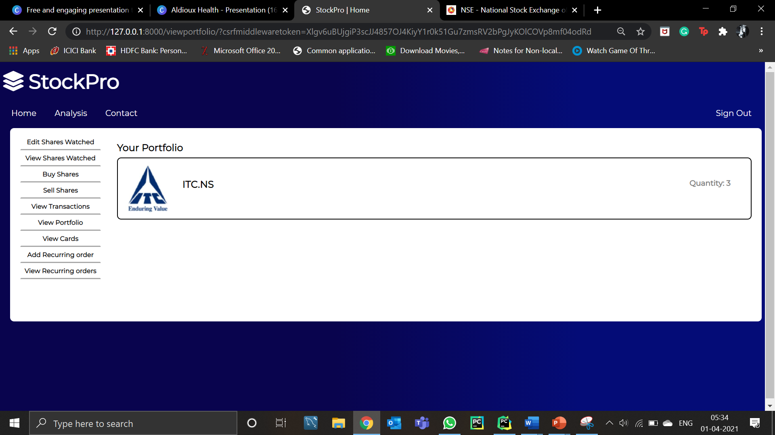
Transaction History
Cards Used
Portfolio

Slide 17
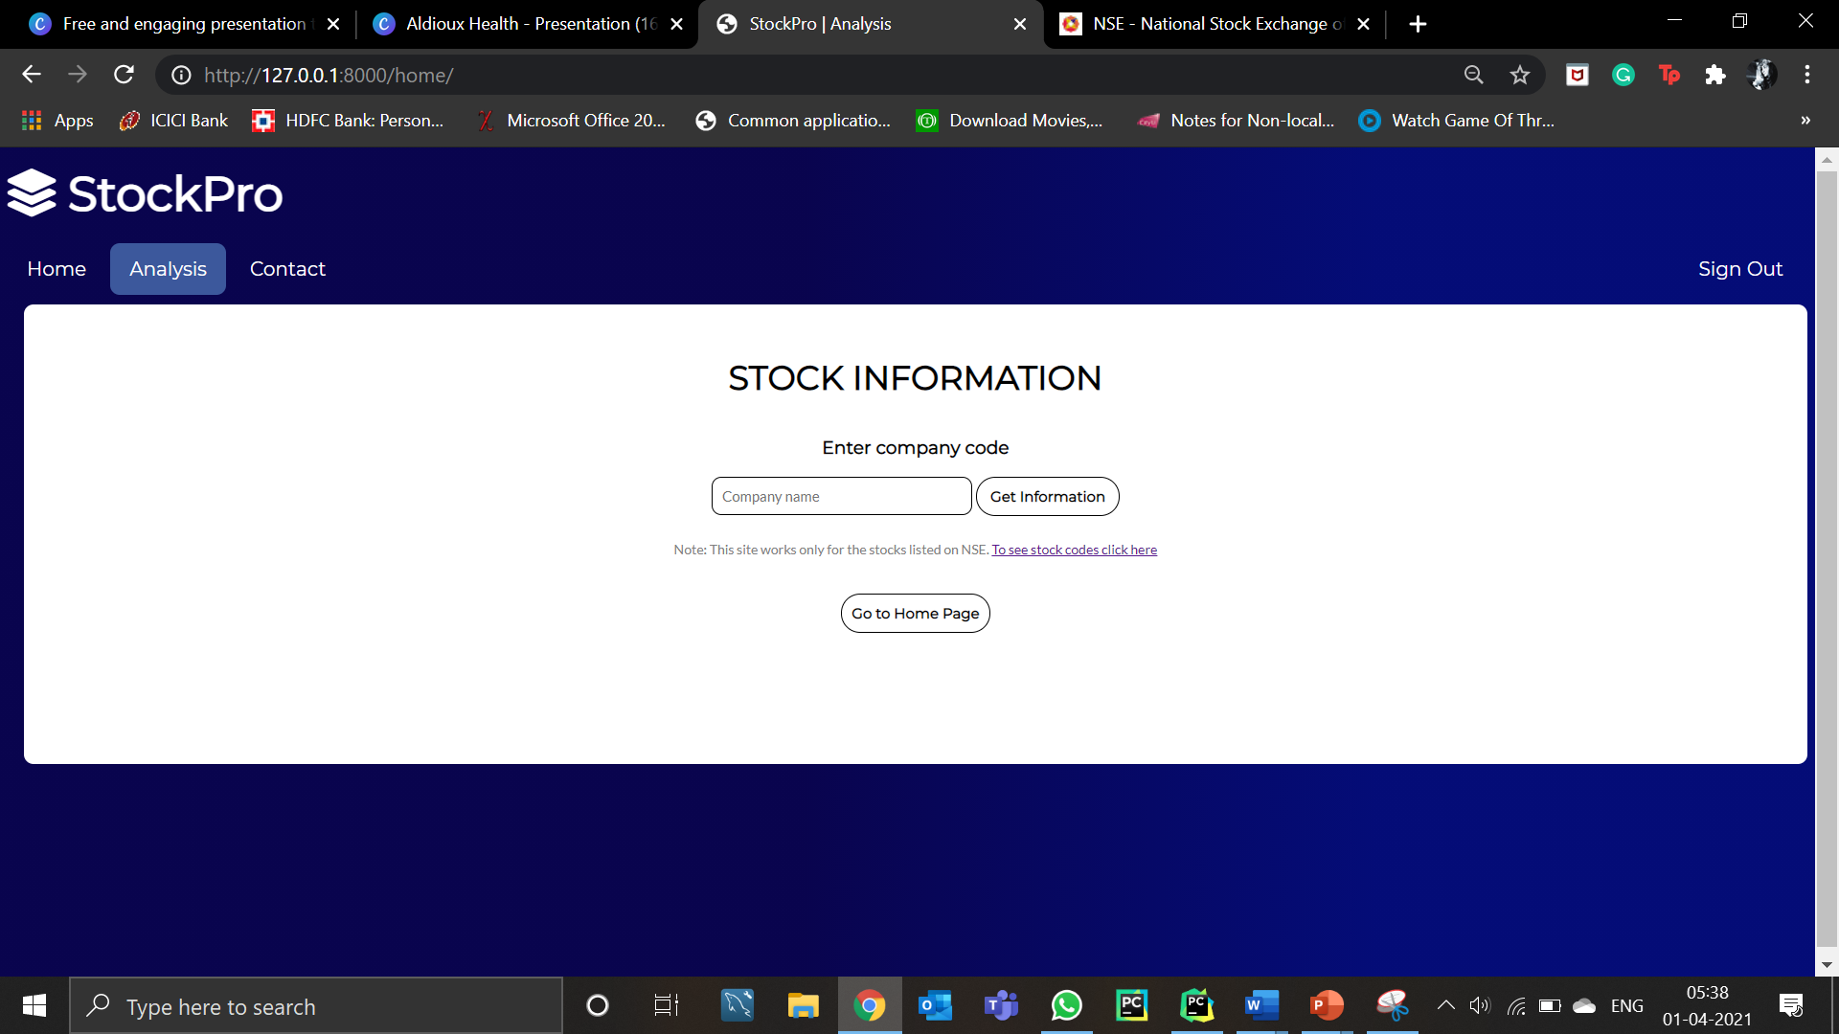
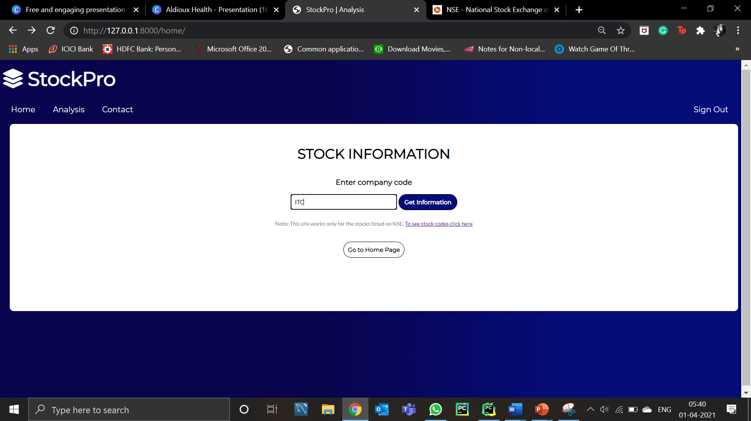
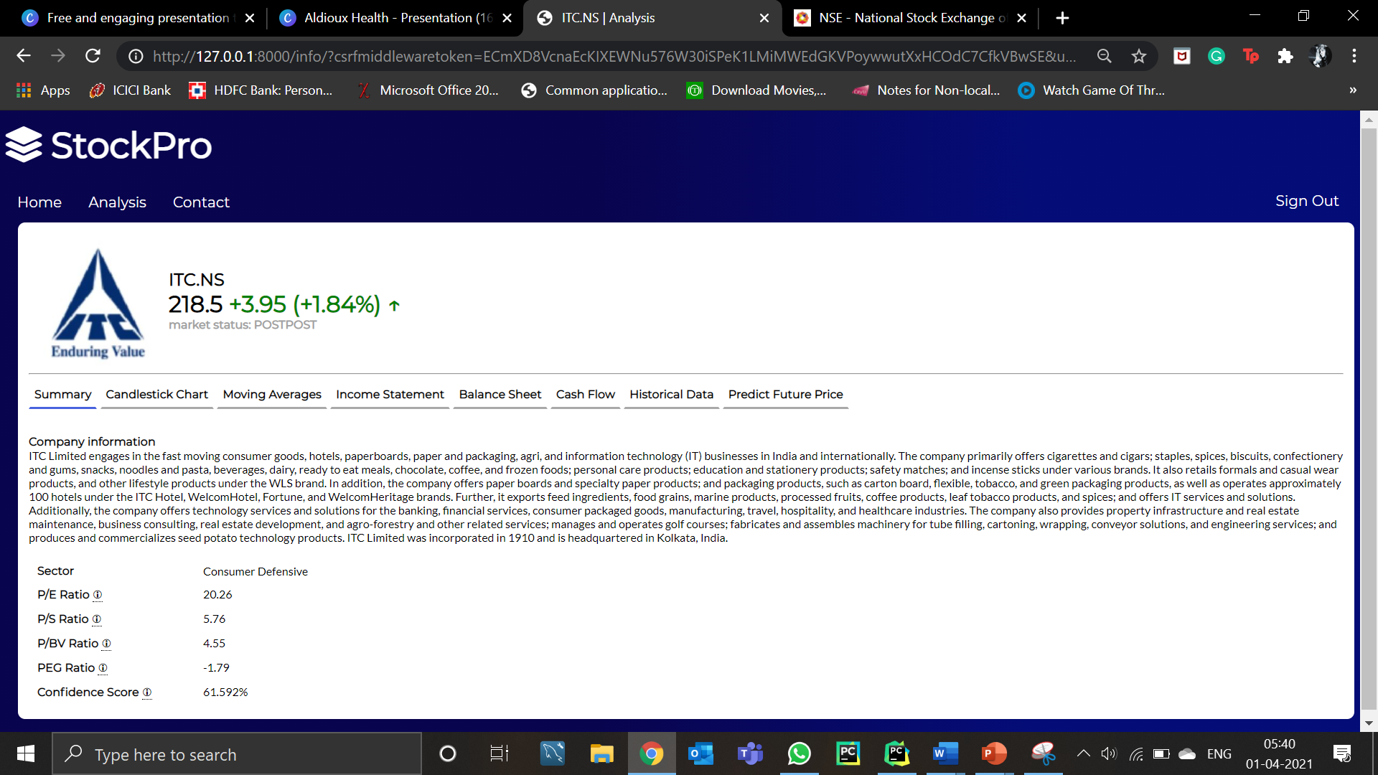
Stock Analysis
Page
Summary of the Stock

Slide 18
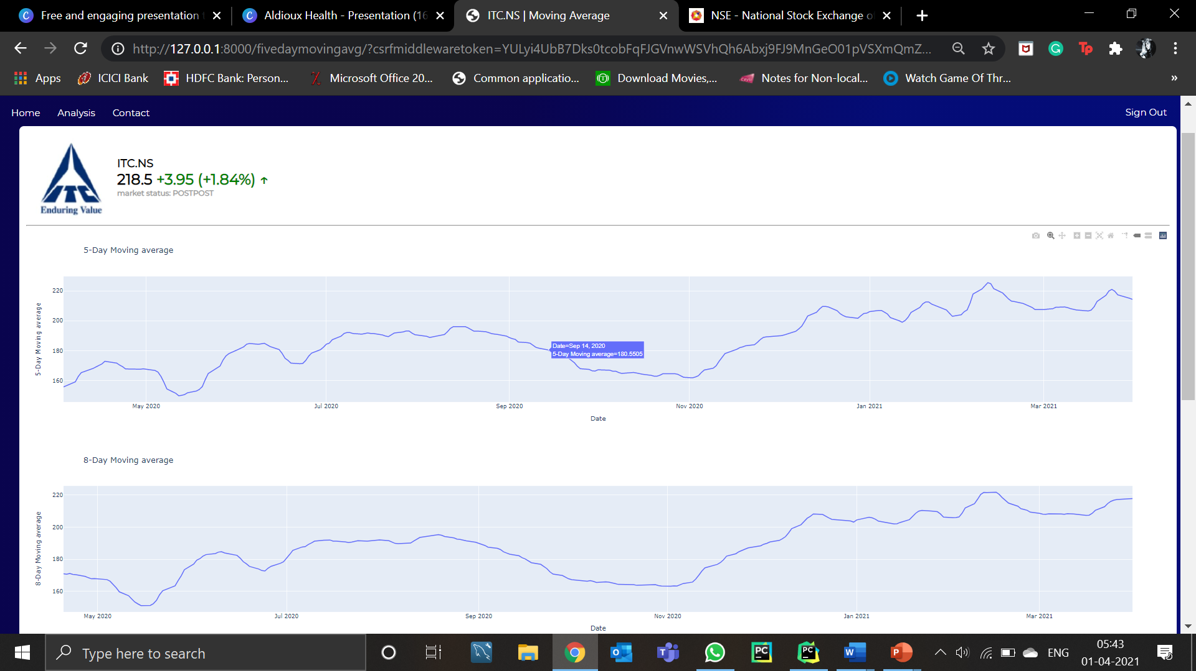
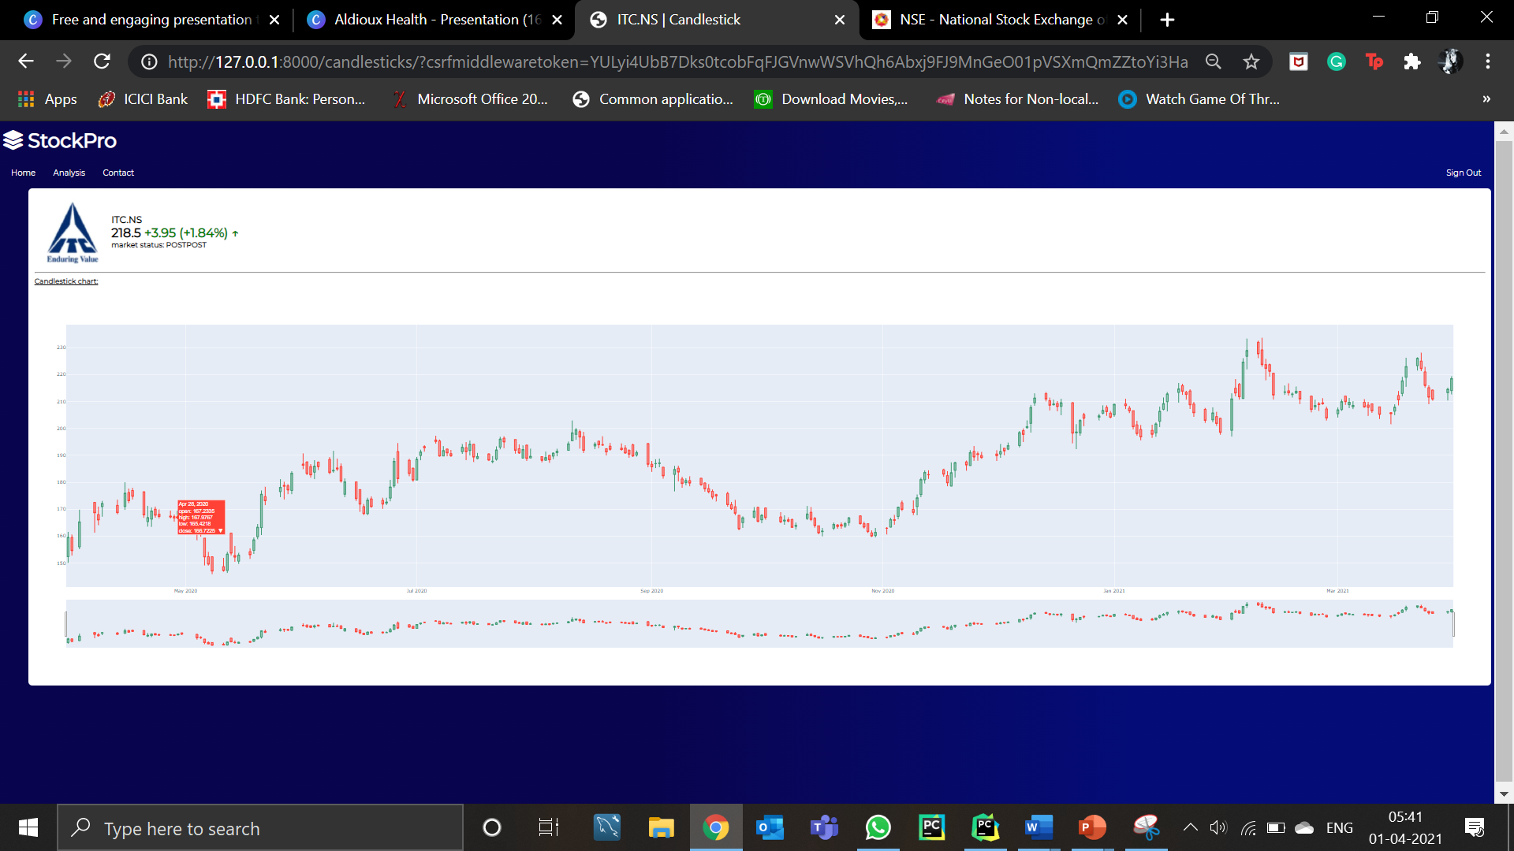
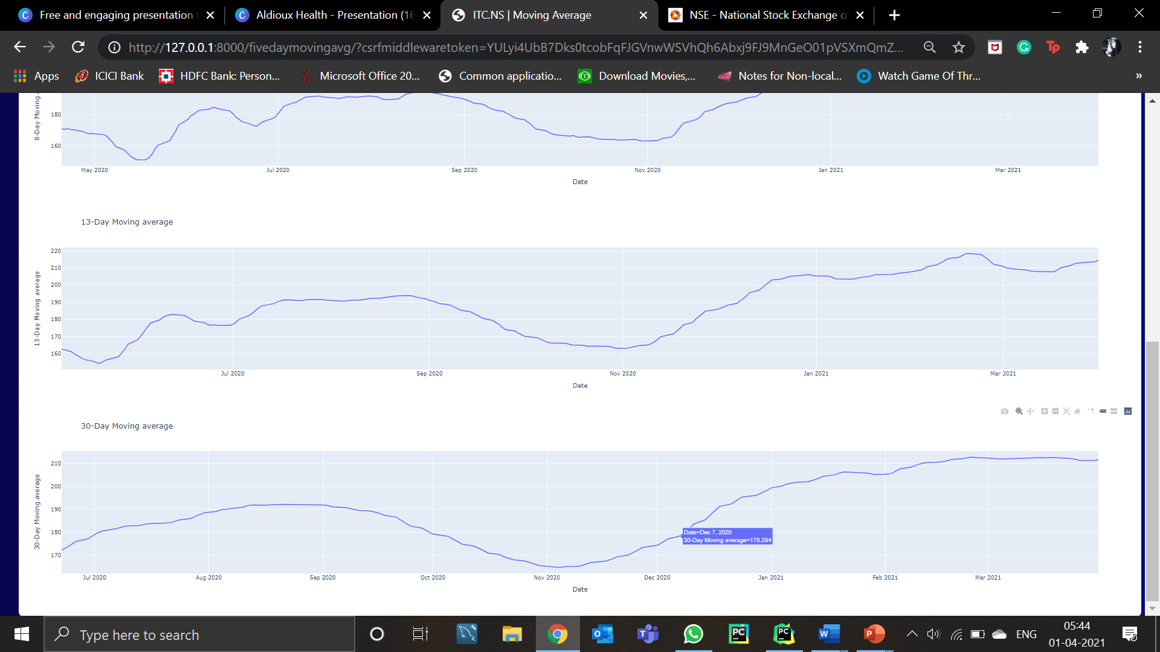
MOVING AVERAGE FOR 5,8, 13 & 30- DAY RESPECTIVELY
Candlestick

Slide 19
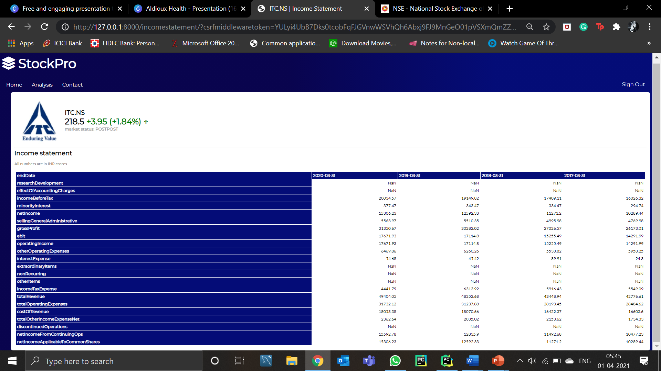
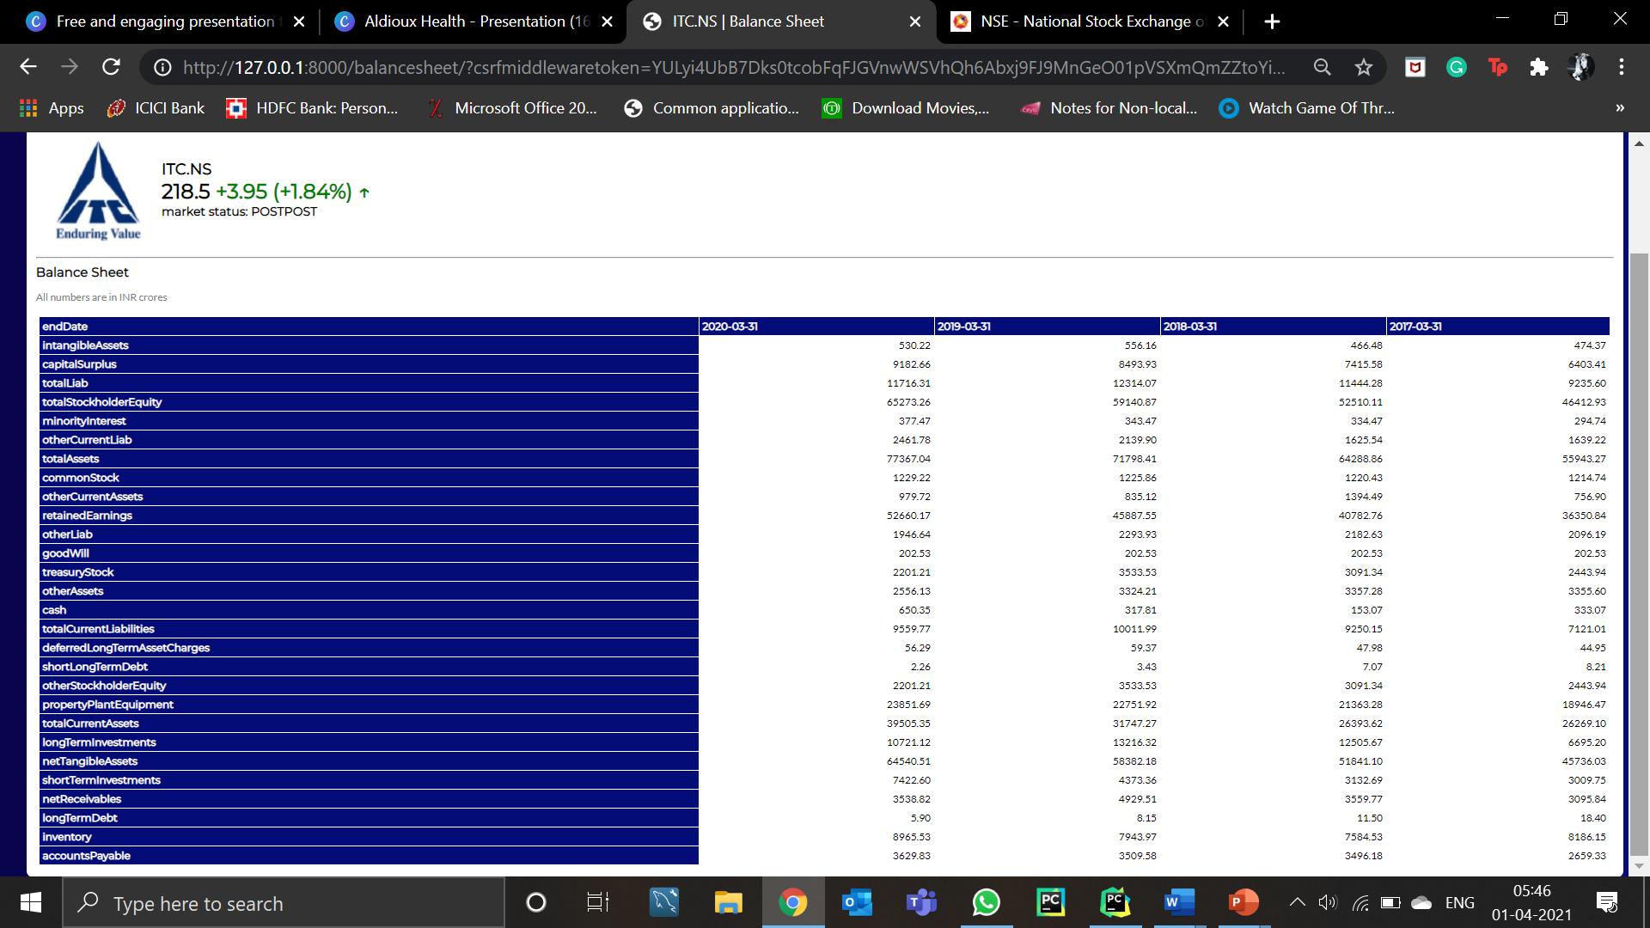
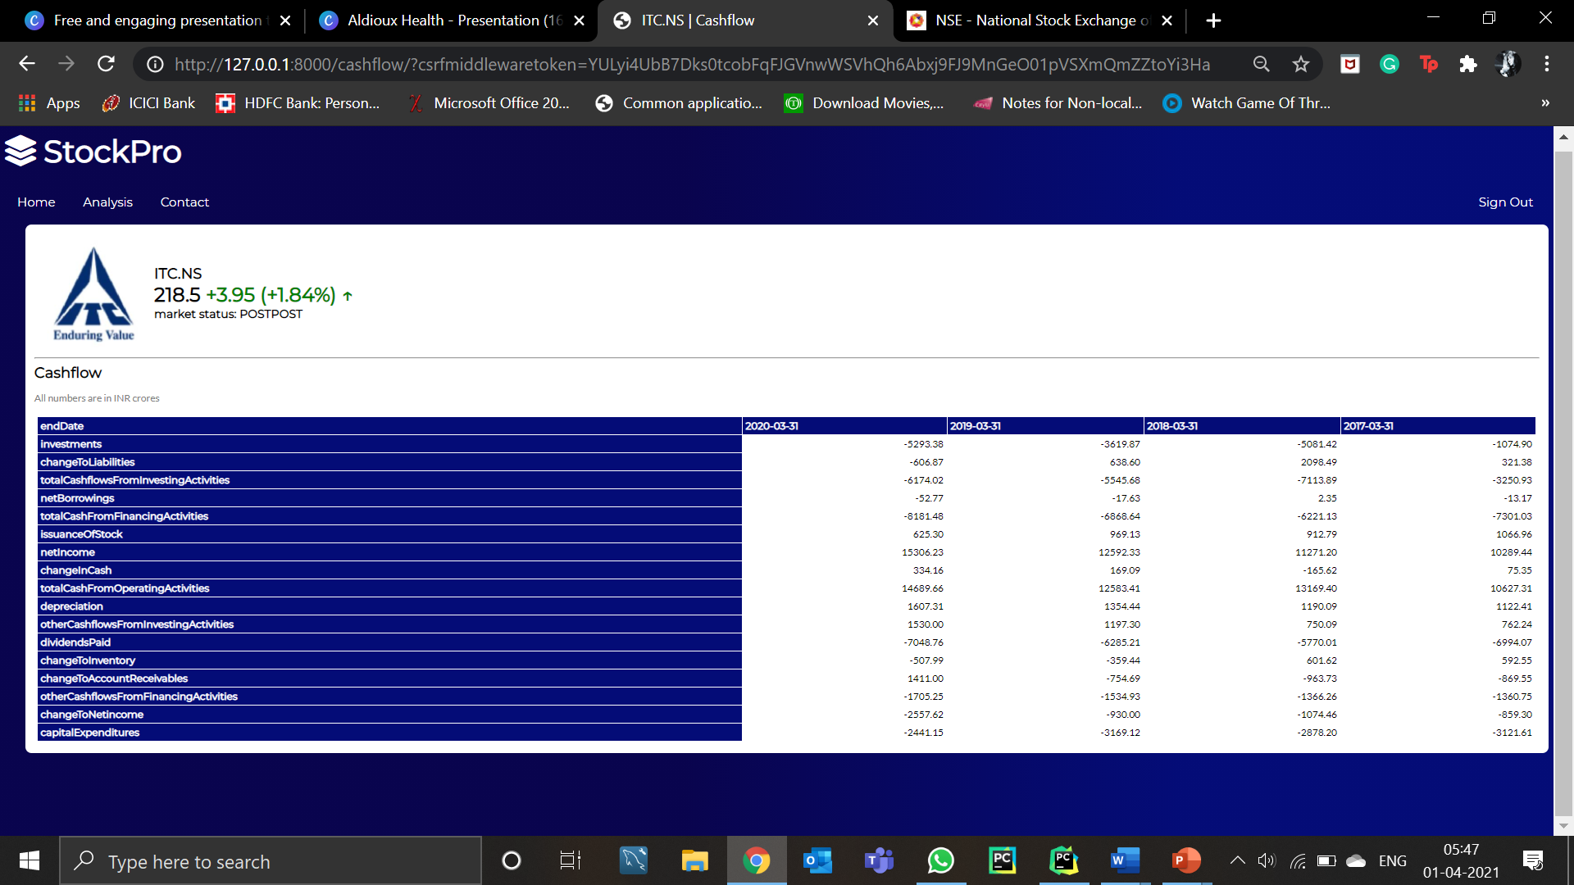
INCOME STATEMENT
BALANCE SHEET
CASHFLOW

Slide 20
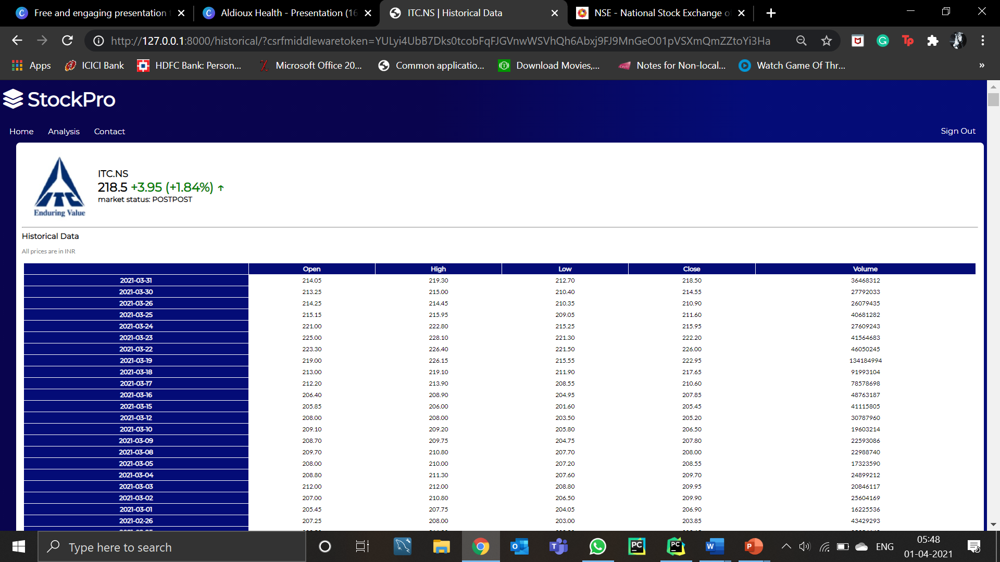
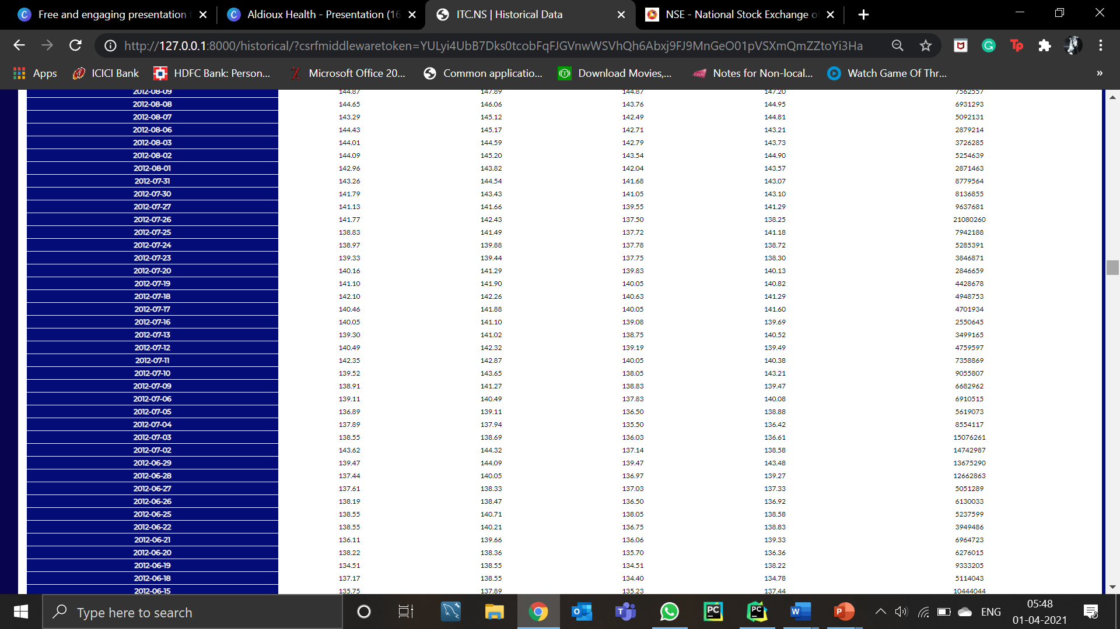
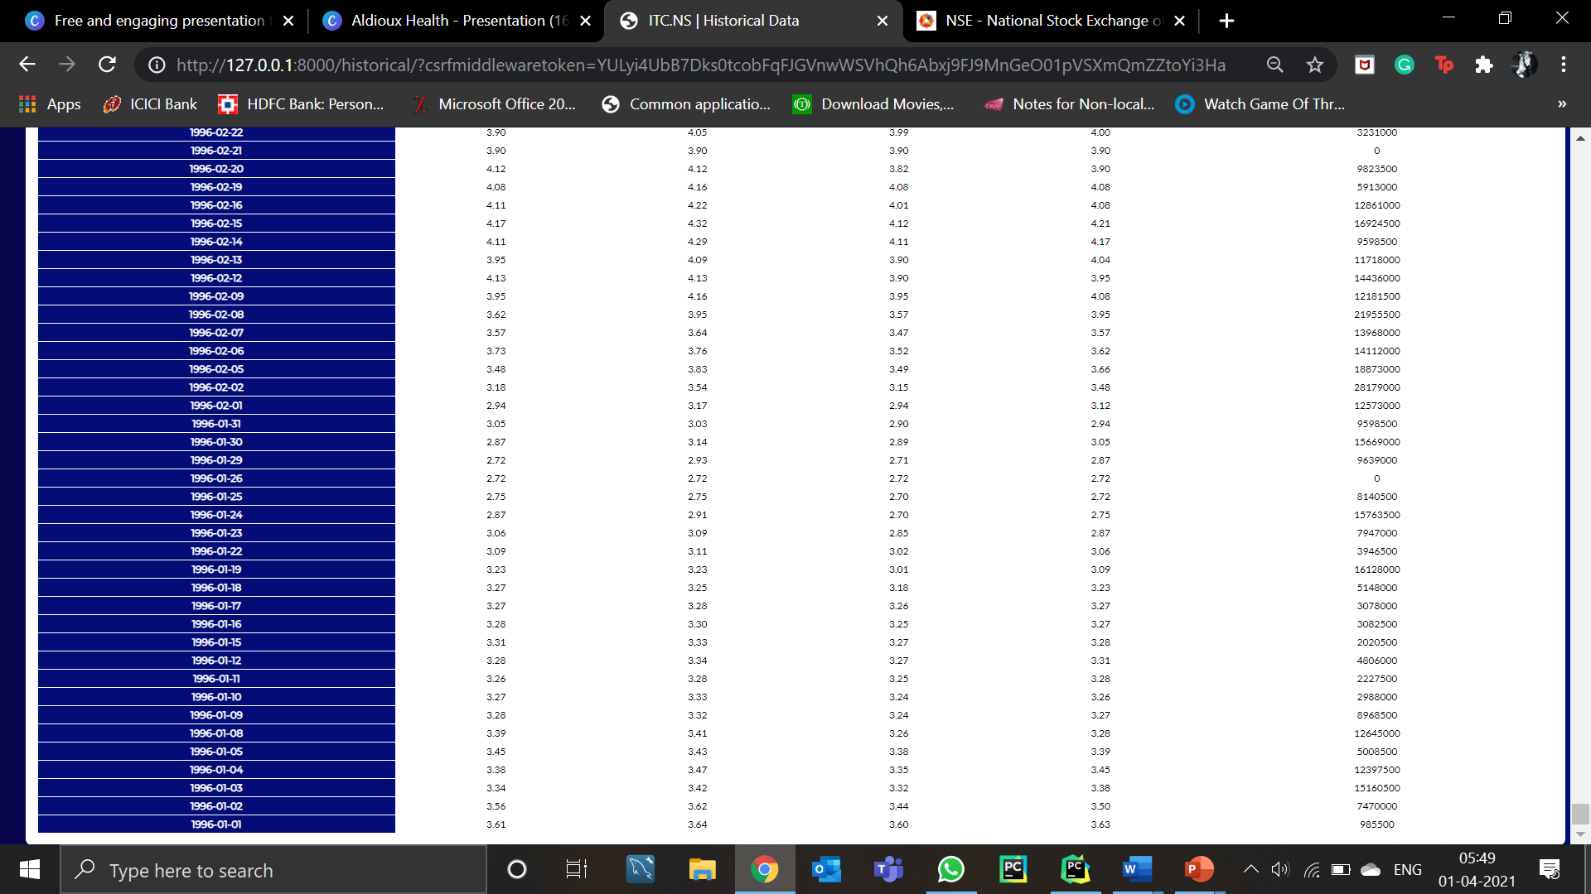
HISTORICAL
DATA OF THE
COMPANY

Slide 21
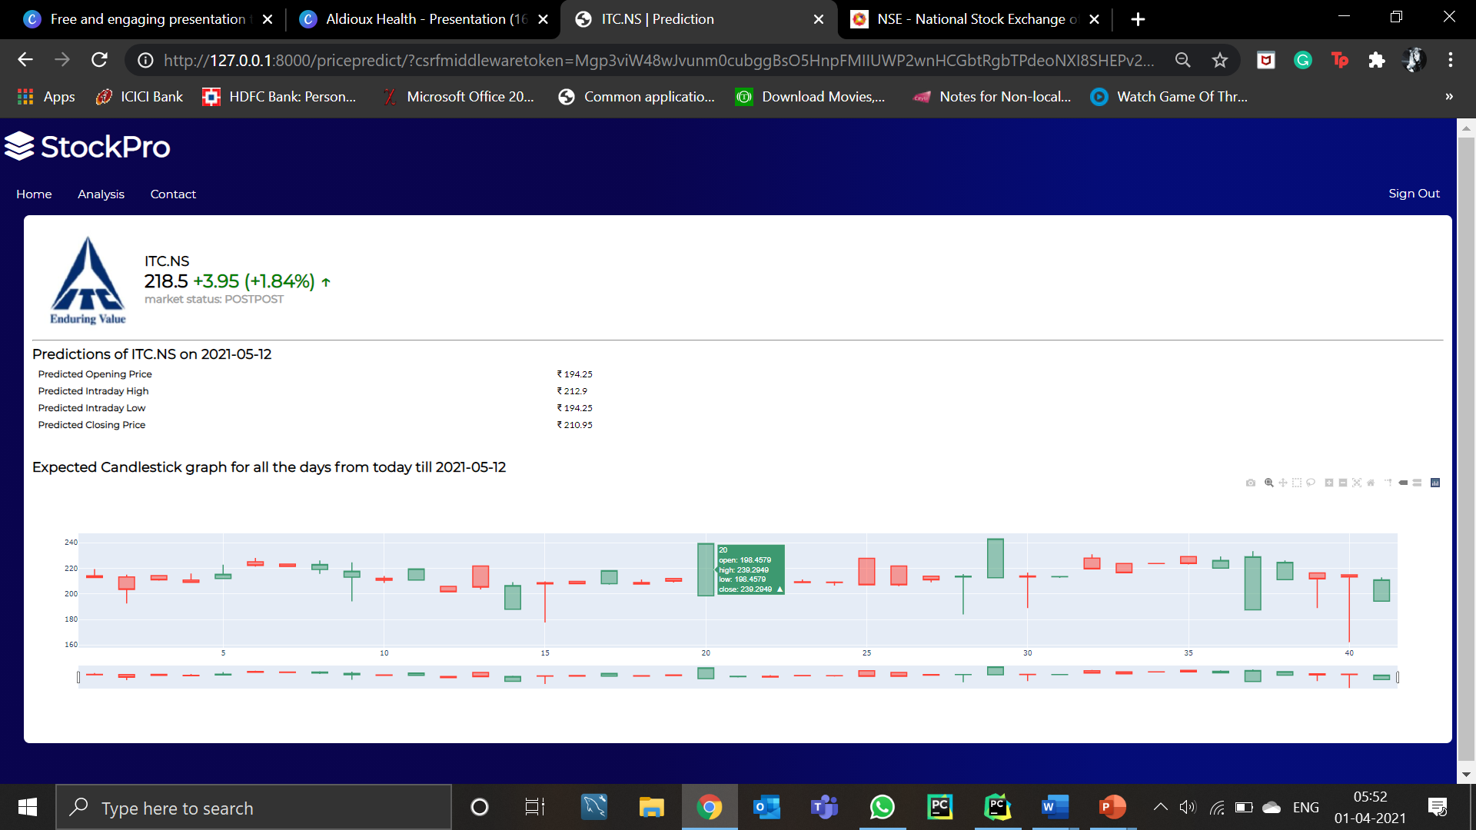
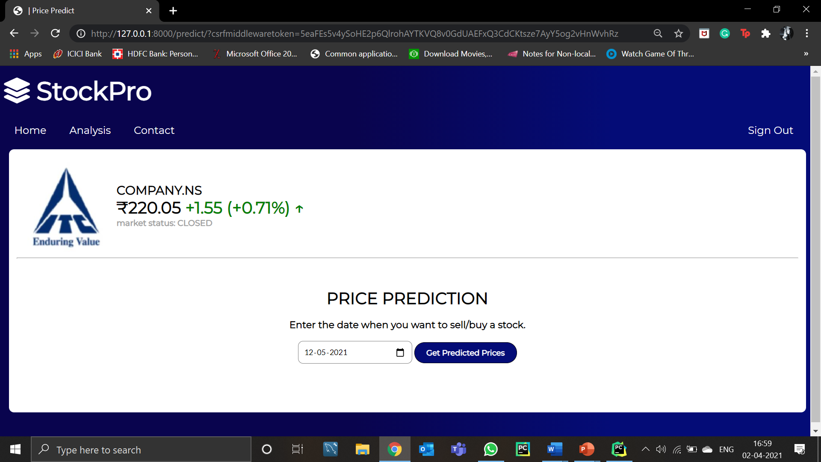
STOCK PRICE PREDICTION

Slide 22
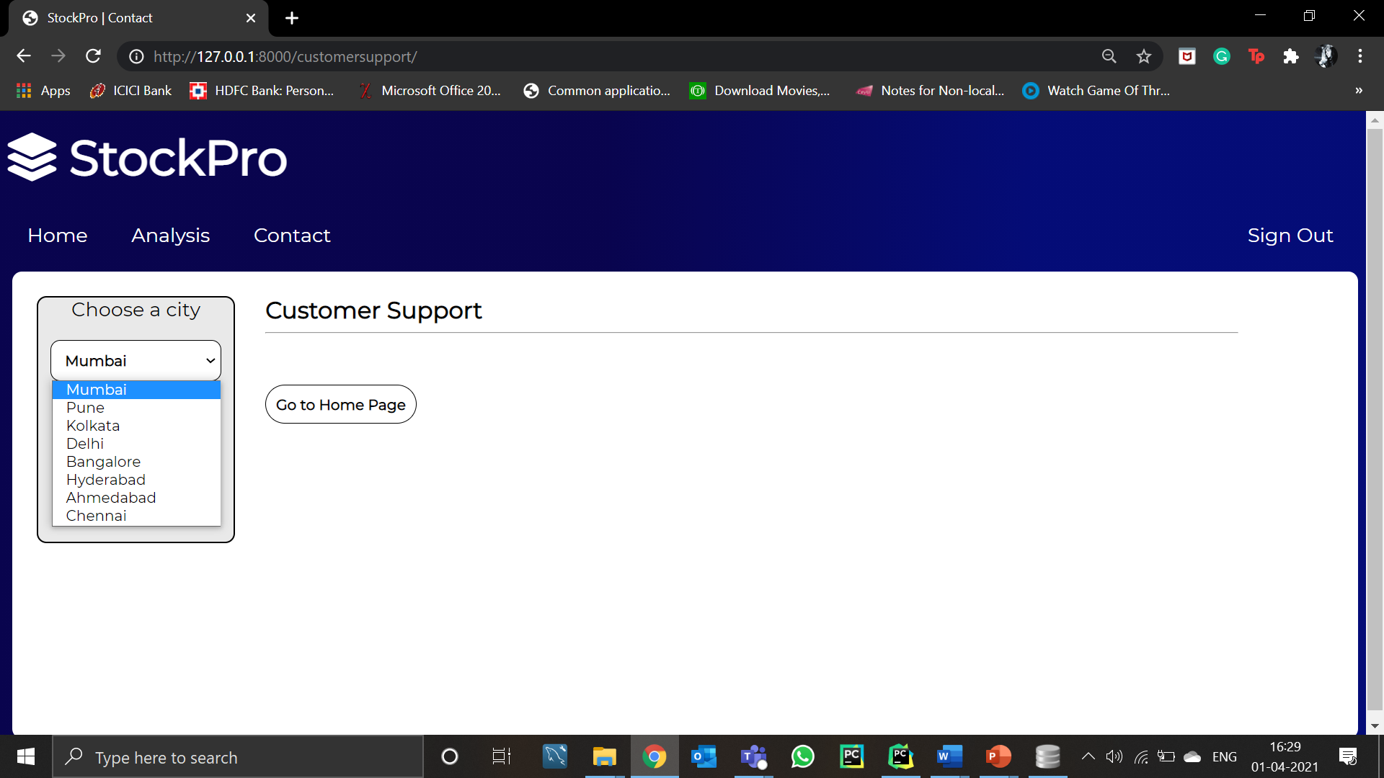
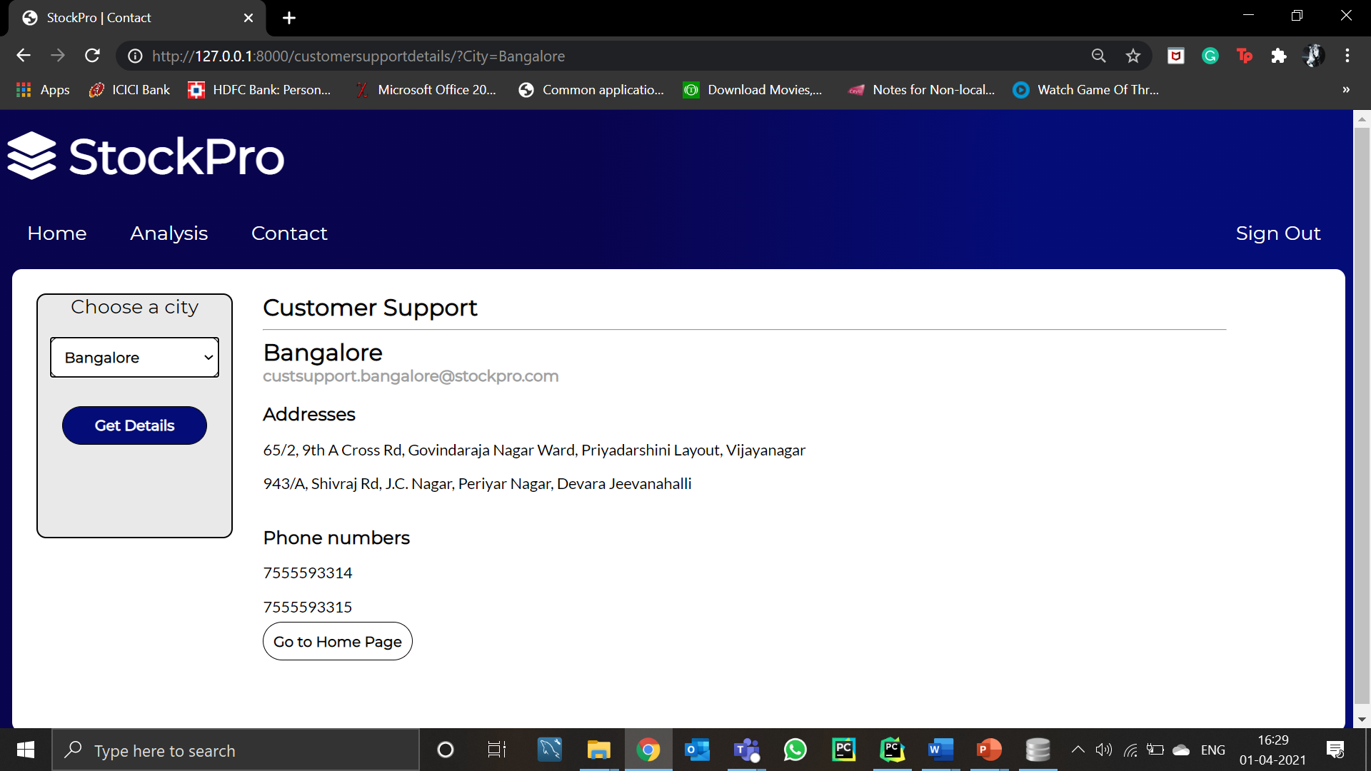
CONTACT PAGE
CUSTOMER SUPPORT

Slide 23
Future Scope
Currently, StockPro is based entirely on stock analysis, trading and predicting of stocks. We can apply the same functionalities to trade Mutual Funds.
It is a model, which we are looking forward to convert it into a startup. We can launch this website and convert it into an actual trading platform linking all the transactions to NSE and CAMS.
It enables trading in all stocks listed in NSE. We can expand this so that users can trade stocks from markets across the globe.
Other than stock and mutual fund trading, we can integrate a platform where user can trade in derivatives.

Slide 24
CONCLUSION & SOCIETAL APPLICATION
A stock market is a key feature found in any economy with a substantial private sector. It facilitates firms selling shares to raise funds for new investment by assuring potential purchasers that they can easily resell their shares when they wish to. The shares sold this way provide individuals a way to save for the future that, although involving risk, has historically yielded higher returns on average than bank deposits. The prices determined by trading in the stock market serve as signals that help allocate society’s scarce savings to the most promising new investment projects and help discipline managers to make the best use of the productive capacity already under their control. Finally, the stock market helps a saver who chooses to invest in stock a way, through diversification, to moderate the risk involved without sacrificing expected return.
In this project we have successfully implemented a model analyzing, trading and predicting future prices of a stock. A platform where we have given the user convenience of buying/selling stocks listed on NSE, viewing the stock portfolio, placing recurring orders and easily viewing transaction all on one platform. We have also designed two machine learning models which helps the user analyze, predict and provided the user with graphing facility for each stock.

Slide 25
We take this opportunity to express our profound gratitude and deep regards to our teachers Prof. Kamal Mistry and Prof Ameyaa Biwalkar for their exemplary guidance, monitoring and constant encouragement throughout the course of this project. The blessing, help and guidance given by them have been a significant help
THANK YOU☺

